Slide 1
SQL Final Project
Sales Performance Analysis of Walmart Stores
Using Advanced MySQL Techniques

Slide 2

Task 1: Identifying the Top Branch by Sales Growth Rate
Query
WITH Monthlysales As (Select Branch, date_format(STR_TO_DATE(date,'%d-%m-%Y'), '%Y-%M') As YearMonth, SUM(TOTAL) AS Total_SalesFROM WALMART GROUP BY Branch, Yearmonth),GrowthRate As (select Branch, YearMonth, Total_Sales, Lag(Total_Sales) over (Partition by Branch Order By Yearmonth) AS Previous_Month_Sales,Round(((Total_Sales - Lag(Total_Sales) over (Partition by Branch Order by YearMonth)) / Lag(Total_Sales) over (Partition by Branch Order by YearMonth))*100, 2) as Growthrate_PercentageFrom Monthlysales) select * From Growthrate where Growthrate_Percentage is not Nullorder by Growthrate_Percentage DESC Limit 1;

Slide 3
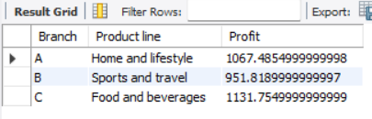
Task 2: Finding the Most Profitable Product Line for Each Branch
Query
With Productline_Profit As( select Branch, `Product Line`, sum(`Gross Income` - 'Cogs') As Profitfrom walmartGroup by Branch, `Product line`),ProfitRanking as (Select *, Row_number() over (Partition by Branch order by Profit desc) as Rank_nofrom Productline_Profit)select Branch, `Product line`, Profit from ProfitRanking where rank_no = 1;

Slide 4
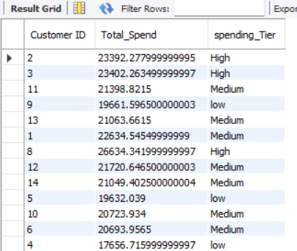
Task 3: Analyzing Customer Segmentation Based on Spending
Query
select `Customer ID`, Sum(total) as Total_Spend,case when sum(Total) > 23000 then 'High'when sum(Total) > 20000 then 'Medium'else 'low'end as spending_Tierfrom walmartGroup by `Customer ID`;

Slide 5
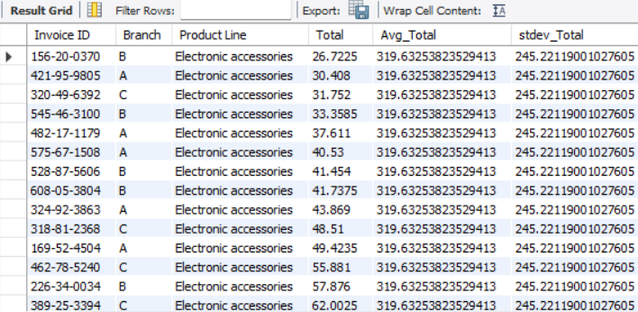
Task 4 Detecting Anomalies in Sales Transactions
Query
with Productstats as ( select `Product line`, Avg(Total) as Avg_Total,STDDEV(Total) as Stdev_Total from walmart Group by `Product Line`) select w.`Invoice ID`, w.Branch, w.`Product Line`, w.Total, ps.Avg_Total, ps.stdev_Totalfrom walmart wjOIN Productstats ps on w.`Product line` = ps.`product line`where w.Total < (ps.avg_total - 2 * ps.stdev_total)orw.Total < (ps.avg_total + 2 * ps.stdev_total)order by w.`Product line`, w.total;

Slide 6
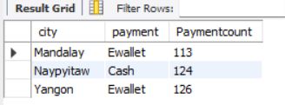
Task 5 Most Popular Payment Method by City
Query
select * from walmart;select city, count(Payment) from walmart;with Payment_Counts as ( Select City, Payment, Count(*) as Paymentcount,Row_number() over (Partition by City order by count(*) desc) as Ranknumberfrom walmartgroup by City, Payment)select city, payment, Paymentcount from Payment_counts where ranknumber = 1;

Slide 7
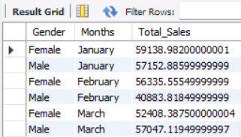
Task 6: Monthly Sales Distribution by Gender
Query
Select Gender, monthname(STR_TO_DATE(date,'%d-%m-%Y')) As Months, SUM(TOTAL) AS Total_SalesFROM WALMART GROUP BY month(STR_TO_DATE(date,'%d-%m-%Y')),months, Genderorder bymonth(STR_TO_DATE(date,'%d-%m-%Y')),Gender;

Slide 8
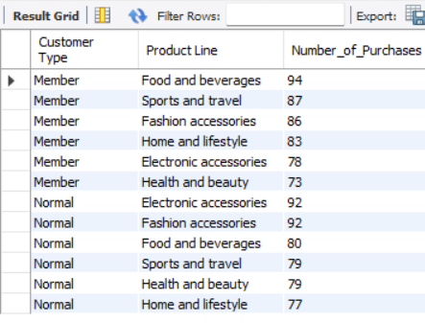
Task 7: Best Product Line by Customer Type
Query
select `Customer Type`, `Product Line`, Count(*) as Number_of_Purchasesfrom walmart group by `Customer type`, `Product line` order by `Customer type`, Number_of_Purchases desc;

Slide 9
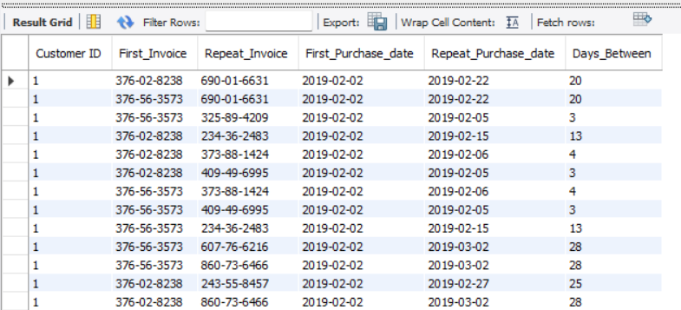
Task 8 Identifying Repeat Customers
Query
SELECT a.`Customer ID`,a.`Invoice id` as First_Invoice,b.`Invoice id` as Repeat_Invoice,STR_TO_DATE(a.date,'%d-%m-%Y') as First_Purchase_date,STR_TO_DATE(b.date,'%d-%m-%Y') as Repeat_Purchase_date,Datediff(STR_TO_DATE(b.date,'%d-%m-%Y'),STR_TO_DATE(a.date,'%d-%m-%Y')) as Days_Betweenfromwalmart ajoinwalmart b on a.`Customer ID` = b.`Customer ID`AND STR_TO_DATE(b.date,'%d-%m-%Y') > STR_TO_DATE(a.date,'%d-%m-%Y')AND datediff(STR_TO_DATE(b.date,'%d-%m-%Y'),STR_TO_DATE(a.date,'%d-%m-%Y')) <= 30ORDER BY a.`Customer ID`, a.Date;

Slide 10
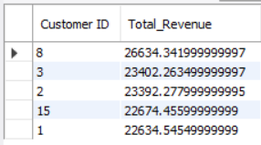
Task 9: Finding Top 5 Customers by Sales Volume
Query
select `Customer ID`, SUM(Total) as Total_Revenuefrom walmartgroup by `Customer ID`order by Total_Revenue desc Limit 5;

Slide 11
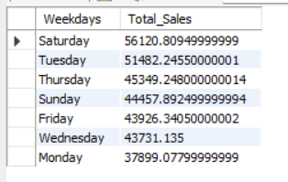
Task 10: Analyzing Sales Trends by Day of the Week
Query
select dayname(STR_TO_DATE(Date, '%d-%m-%Y')) As Weekdays, sum(total) as Total_SalesFrom Walmartgroup by WeekdaysOrder by Total_sales desc;

Slide 12
THANK YOU
Presentation Video Link :-
https://drive.google.com/drive/folders/1gW74vx2EDXUCHi3F8q-SPGFusEK8j264

